Slide 1
Patterns
Rakib Mahmud

Slide 2
Pattern Type-1 (Right Angle Triangle)
1
1 2
1 2 3
1 2 3 4
1
1 0
1 0 1
1 0 1 0
A
A B
A B C
A B C D
*
* *
* * *
* * * *
Pattern 1 (N =4)
Pattern 2 (N =4)
Pattern 3 (N =4)
Pattern 4 (N =4)
1
2 2
3 3 3
4 4 4 4
1
0 0
1 1 1
0 0 0 0
A
B B
C C C
D D D D
#
# #
# # #
# # # #
Pattern 5 (N =4)
Pattern 6 (N =4)
Pattern 7 (N =4)
Pattern 8 (N =4)

Slide 3
Pattern1 from pattern type1
1
1 2
1 2 3
1 2 3 4
col1
row1
1
1 | 2
1 | 2 | 3
1 | 2 | 3 | 4
col2
row2
col3
row3
col4
row4

Slide 4
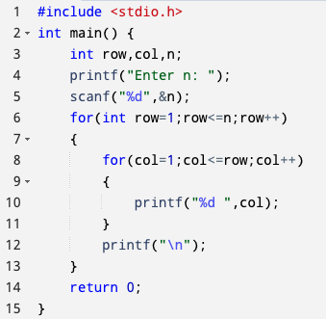
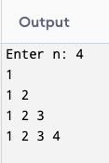
C Program for Pattern1 from pattern type1

Slide 5
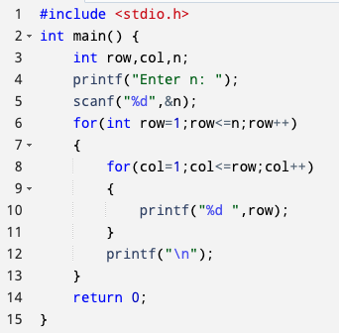
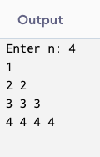
C Program for Pattern5 from pattern type1

Slide 6
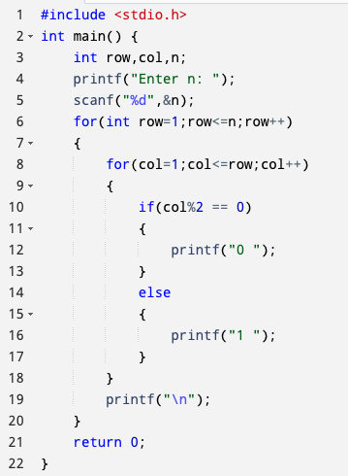
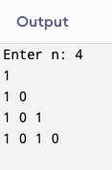
C Program for Pattern2 from pattern type1

Slide 7
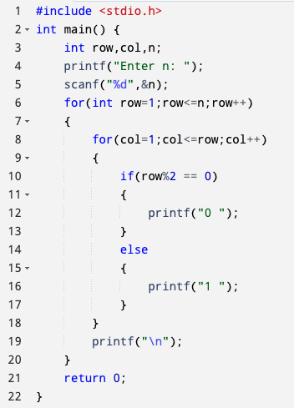
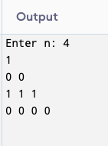
C Program for Pattern6 from pattern type1

Slide 8
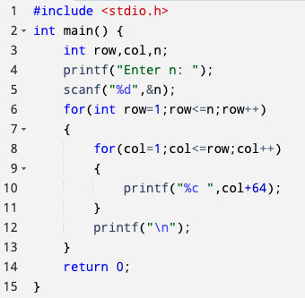
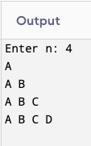
C Program for Pattern3 from pattern type1

Slide 9
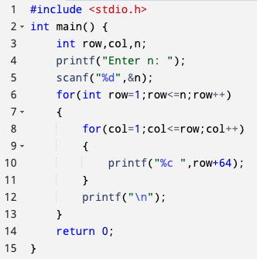
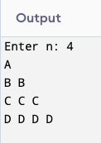
C Program for Pattern7 from pattern type1

Slide 10
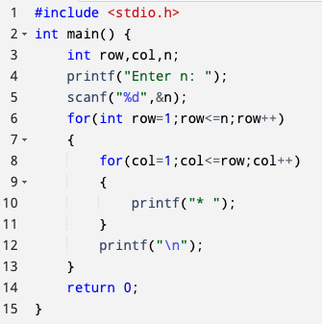
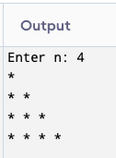
C Program for Pattern4 from pattern type1

Slide 11
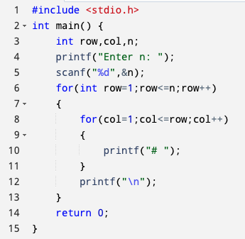
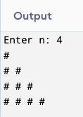
C Program for Pattern8 from pattern type1

Slide 12
Pattern Type 2
1 2 3 4
1 2 3
1 2
1
1 0 1 0
1 0 1
1 0
1
A B C D
A B C
A B
A
* * * *
* * *
* *
*
Pattern 1 (N =4)
Pattern 2 (N =4)
Pattern 3 (N =4)
Pattern 4 (N =4)
4 4 4 4
3 3 3
2 2
1
0 0 0 0
1 1 1
0 0
1
D D D D
C C C
B B
A
# # # #
# # #
# #
#
Pattern 5 (N =4)
Pattern 6 (N =4)
Pattern 7 (N =4)
Pattern 8 (N =4)

Slide 13
Pattern1 from pattern type2
1 2 3 4
1 2 3
1 2
1
col1
col2
col3
col4
row4
1 | 2 | 3 | 4
1 | 2 | 3
1 | 2
1
row3
row2
row1

Slide 14
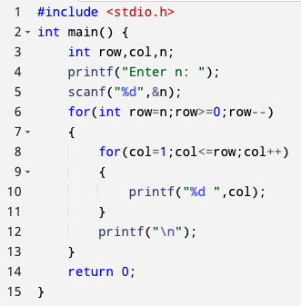
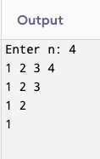
C Program for Pattern1 from pattern type2

Slide 15
Pattern Type 3
1
1 2
1 2 3
1 2 3 4
1
1 2
1 2 3
1 2 3 4
1 2 3 4
1 2 3
1 2
1
1
1 2
1 2 3
1 2 3 4
1 2 3
1 2
1
1
2 2
3 3 3
4 4 4 4
3 3 3
2 2
1
A
A B
A B C
A B C D
A B C
A B
A
A
B B
C C C
D D D D
C C C
B B
A
1
0 0
1 1 1
0 0 0 0
1 1 1
0 0
1
1
1 0
1 0 1
1 0 1 0
1 0 1
1 0
1
*
* *
* * *
* * * *
* * *
* *
*
#
# #
# # #
# # # #
# # #
# #
#
1 2 3 4
1 2 3
1 2
1
Pattern1
Pattern2
Pattern3
Pattern4
Pattern5
Pattern6
Pattern7
Pattern8

Slide 16
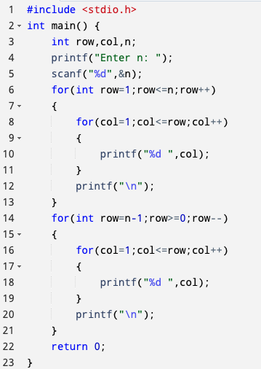
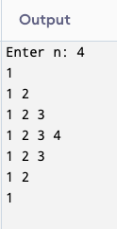
C Program for Pattern1 from pattern type3

Slide 17
Pattern Type 4
1
1 2
1 2 3
1 2 3 4
1
1 0
1 0 1
1 0 1 0
A
A B
A B C
A B C D
*
* *
* * *
* * * *
Pattern 1 (N =4)
Pattern 2 (N =4)
Pattern 3 (N =4)
Pattern 4 (N =4)
1
2 2
3 3 3
4 4 4 4
1
0 0
1 1 1
0 0 0 0
A
B B
C C C
D D D D
#
# #
# # #
# # # #
Pattern 5 (N =4)
Pattern 6 (N =4)
Pattern 7 (N =4)
Pattern 8 (N =4)

Slide 18
Pattern1 from pattern type4
1
1 2
1 2 3
1 2 3 4
col1
col2
col3
col4
row1
 |  |  | 1
 |  | 1 | 2
 | 1 | 2 | 3
1 | 2 | 3 | 4
row2
row3
row4
Space = n-row

Slide 19
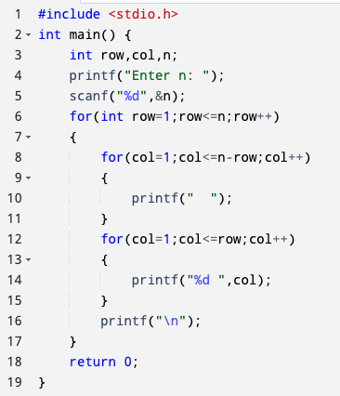
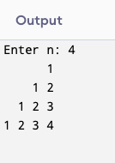
C Program for Pattern1 from pattern type4

Slide 20
Pattern Type 5
1 2 3 4
1 2 3
1 2
1
1 0 1 0
1 0 1
1 0
1
A B C D
A B C
A B
A
* * * *
* * *
* *
*
Pattern 1 (N =4)
Pattern 2 (N =4)
Pattern 3 (N =4)
Pattern 4 (N =4)
4 4 4 4
3 3 3
2 2
1
0 0 0 0
1 1 1
0 0
1
D D D D
C C C
B B
A
# # # #
# # #
# #
#
Pattern 5 (N =4)
Pattern 6 (N =4)
Pattern 7 (N =4)
Pattern 8 (N =4)

Slide 21
Pattern1 from pattern type5
1 2 3 4
1 2 3
1 2
1
col1
col2
col3
col4
row4
1 | 2 | 3 | 4
 | 1 | 2 | 3
 |  | 1 | 2
 |  |  | 1
row3
row2
row1
Space = n-row

Slide 22
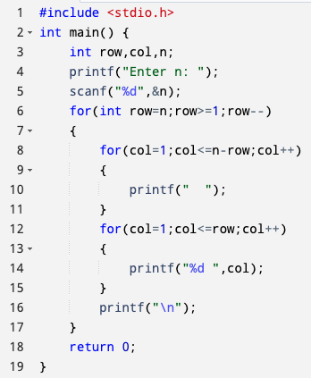
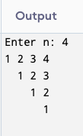
C Program for Pattern1 from pattern type5

Slide 23
Pattern Type 6
1
1 2
1 2 3
1 2 3 4
1
1 2
1 2 3
1 2 3 4
1 2 3 4
1 2 3
1 2
1
1
1 2
1 2 3
1 2 3 4
1 2 3
1 2
1
1
2 2
3 3 3
4 4 4 4
3 3 3
2 2
1
A
A B
A B C
A B C D
A B C
A B
A
A
B B
C C C
D D D D
C C C
B B
A
1
0 0
1 1 1
0 0 0 0
1 1 1
0 0
1
1
1 0
1 0 1
1 0 1 0
1 0 1
1 0
1
*
* *
* * *
* * * *
* * *
* *
*
#
# #
# # #
# # # #
# # #
# #
#
1 2 3 4
1 2 3
1 2
1
Pattern1
Pattern2
Pattern3
Pattern4
Pattern5
Pattern6
Pattern7
Pattern8

Slide 24
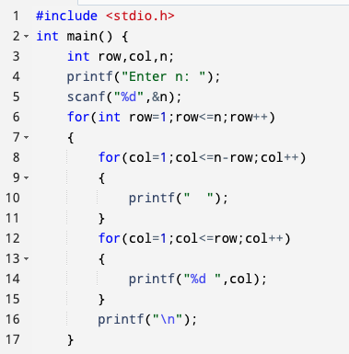
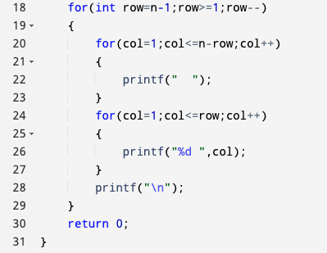
C Program for Pattern1 from pattern type6

Slide 25
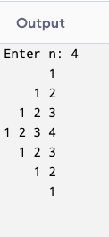
C Program for Pattern1 from pattern type6 (Cont’d)

Slide 26
Exercises
Do from pattern 2 to pattern 8 for pattern type 2 to 6

Slide 27
Thank You

